Slide 1
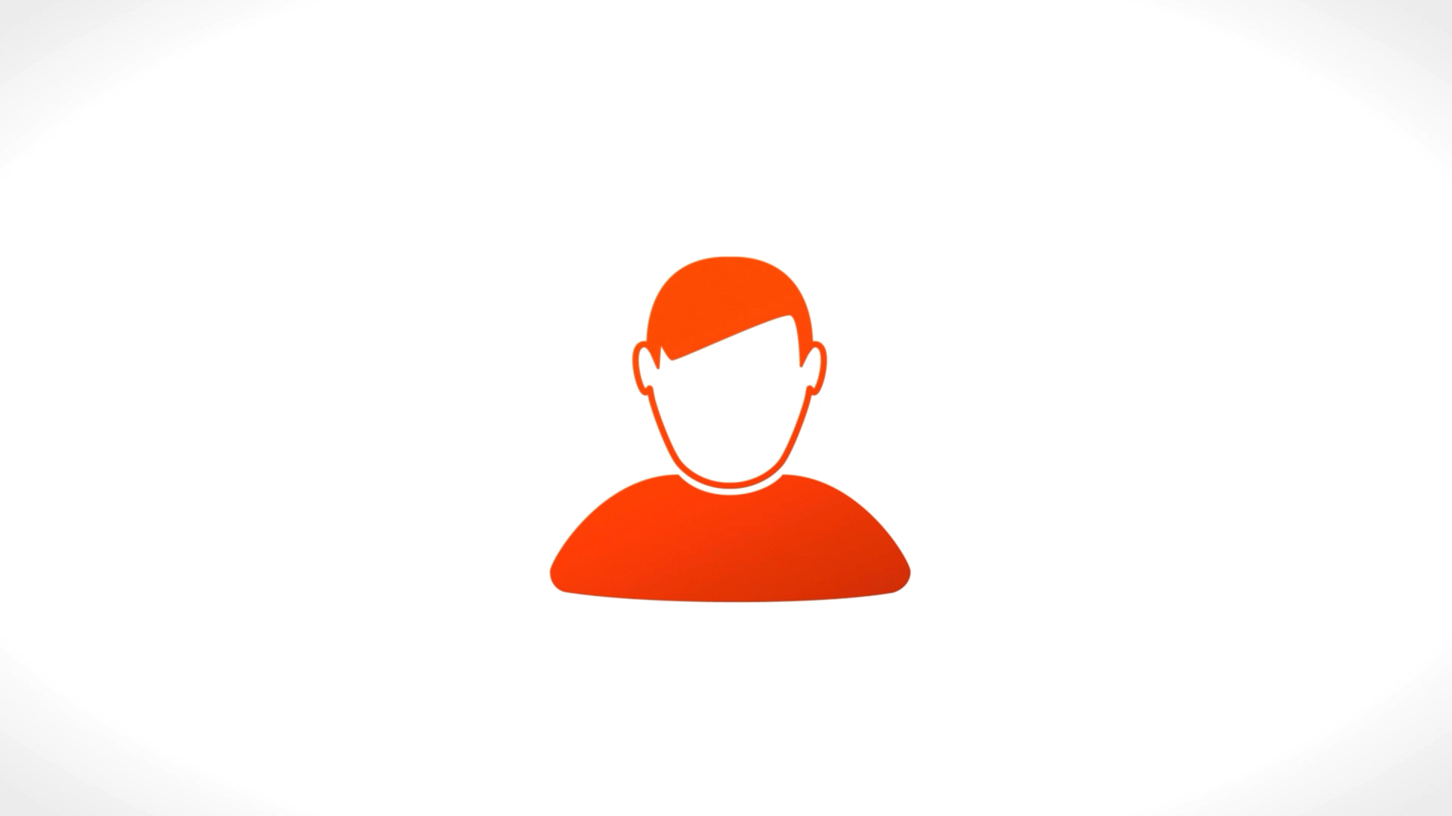
AI Revolution and 8 People behind it
Max Li (李海飞）, PhD
max.li@live.com

Slide 2
AI Revolution is real
Explosive growth of ChatGPT is driven by:
  Real demand
  Not advertising like Pepsi and Coca cola
Before AI “gold rush”, there was “AI winter”

Slide 3
Who are they?
Turing Award Winners:
  Yoshua Bengio, Geoffrey Hinton and Yann LeCun
Stanford Triplet:
  Andrew Ng, Andrej Karpathy and Fei-Fei Li
Dropouts:
  Sam Altman and Elon Musk

Slide 4
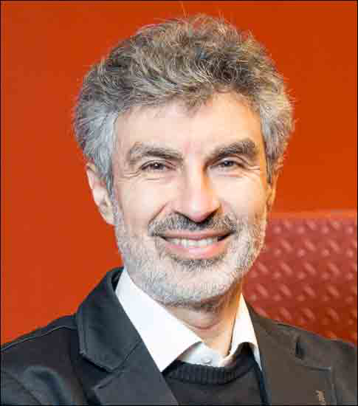
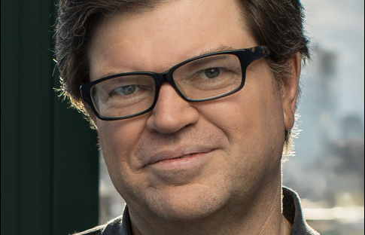
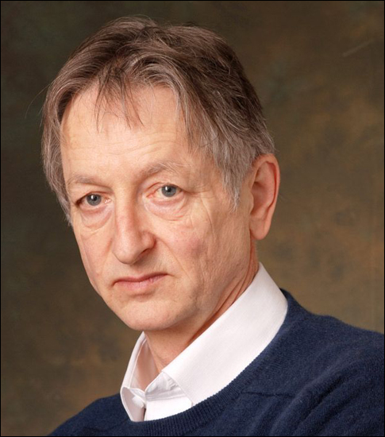
Special about Turing Award?
Nobel Prize in Computing
Godfathers of Deep Learning
Awarded in 2018
Three rebels in AI research

Slide 5
Yoshua Bengio, PhD
Professor at University of Montreal
All degrees from McGill University
Founder of Mila, an independent nonprofit organization with 300 researchers and 35 faculty members
Largest academic center for deep learning research in the world

Slide 6
Geoffrey Hinton, PhD
Resigned from Google over AI safety
University Professor Emeritus at the University of Toronto
Bachelor’s degree in experimental psychology from Cambridge University
Doctoral degree in AI from the University of Edinburgh
Backpropagation algorithm and AlexNet

Slide 7

Yann LeCun(杨立昆), PhD
Professor at NYU and Chief AI Scientist at Meta
a Diplôme d'Ingénieur from the Ecole Superieure d'Ingénieur en Electrotechnique et Electronique (ESIEE)
PhD in computer science from Université Pierre et Marie Curie.
Post Doc at former Bell Labs
MNIST and CNN (Convolutional Neural Network)

Slide 8
Stanford Triplet
Boston used to be the “original” Silicon Valley
  DEC (MIT connection) and Wang Labs (王安电脑, Harvard connection)
Earliest hotspot for AI research at MIT
  CSAIL: Computer Science and Artificial Intelligence Laboratories
John McCarthy moved from MIT to Stanford in 1962
  He coined the term "artificial intelligence" in 1955.
In people’s mind, Silicon Valley = Stanford University

Slide 9
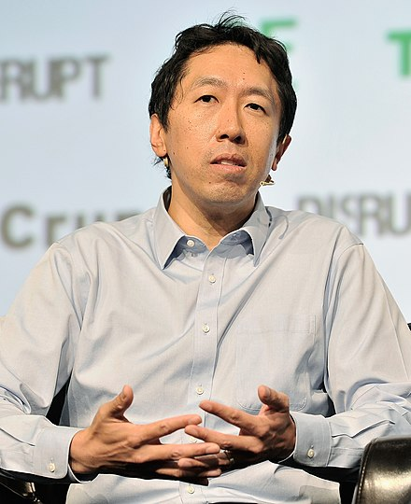
Andrew Ng(吴恩达), PhD
DeepLearning.ai
Parents from Hong Kong, born in UK
BS at CMU, MS at MIT and PhD at UC Berkeley
Many years as professor at Stanford
Google Brain, Baidu and Coursera
AI is the new electricity

Slide 10
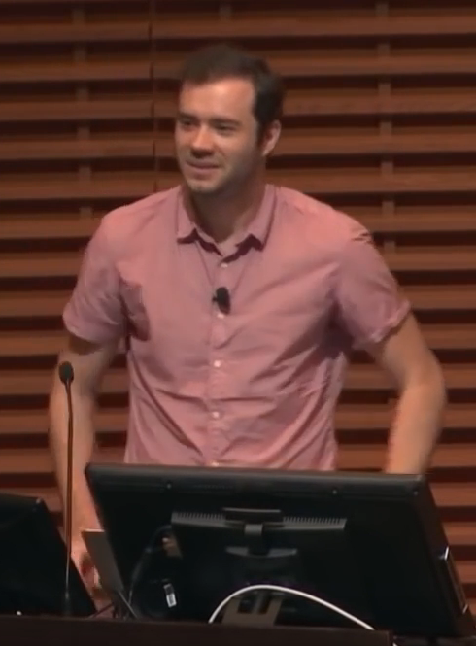
Andrej Karpathy, PhD
Free agent
PhD with Dr. Fei-fei Li
Cofounder of OpenAI
Moved to Tesla with Elon Musk
Returned to OpenAI, quitted in February 2024

Slide 11
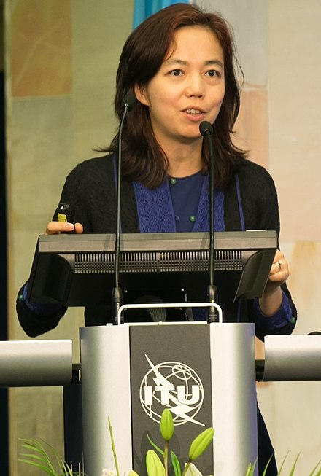
Fei-fei Li（李飞飞）, PhD
Godmother of A.I.
Professor at Stanford, Director of HAI
Born in Beijing, China, raised in Chengdu, China
BS from Princeton, PhD from Caltech
Creator of ImageNet
Autobiography: The Worlds I See: Curiosity, Exploration, and Discovery at the Dawn of AI

Slide 12
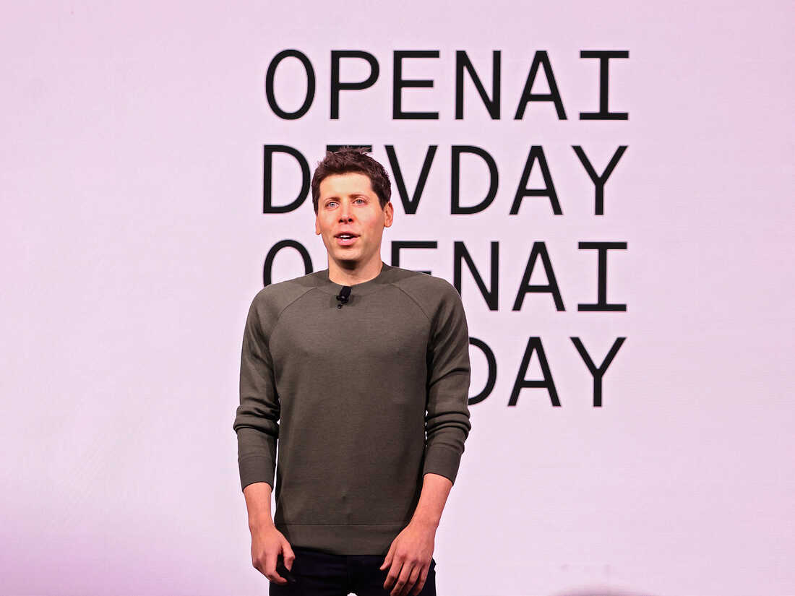
Sam Altman
CEO of OpenAI
Dropped out of Stanford
First company was supported by Y Combinator
Became YC president later on
Cofounded OpenAI with Elon Musk and others
Original plan for OpenAI as a non-profit for AGI research

Slide 13
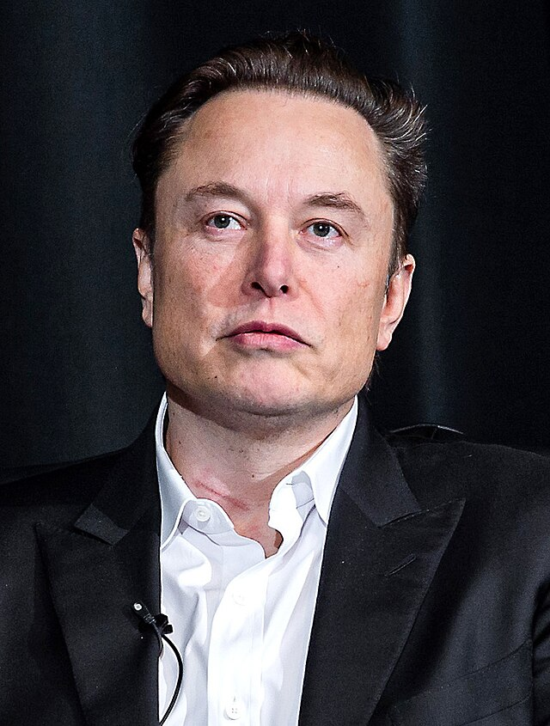
Elon Musk
Born in South Africa, a few years in Canada
BS from UPenn, dropped from Stanford PhD program
Space exploration, electric car and AI
Asperger’s syndrome, a type of ASD
A very controversial figure
Left OpenAI’s board of directors because of its slow progress

Slide 14
Summary
Demographics:
  1 woman, 7 men
  2 ethnic Chinese, 6 Caucasians
  2 in Canada, 6 in USA
  Countries of birth:
    UK (Andrew Ng and Geoffrey Hinton), France (Yann LeCun and Yoshua Bengio), China (Fei-fei Li), South Africa (Elon Musk), Slovakia (Andrej Karpathy), USA (Sam Altman)
  6 PhD, 2 dropouts

